Slide 1
Tree Species Identification

Slide 2
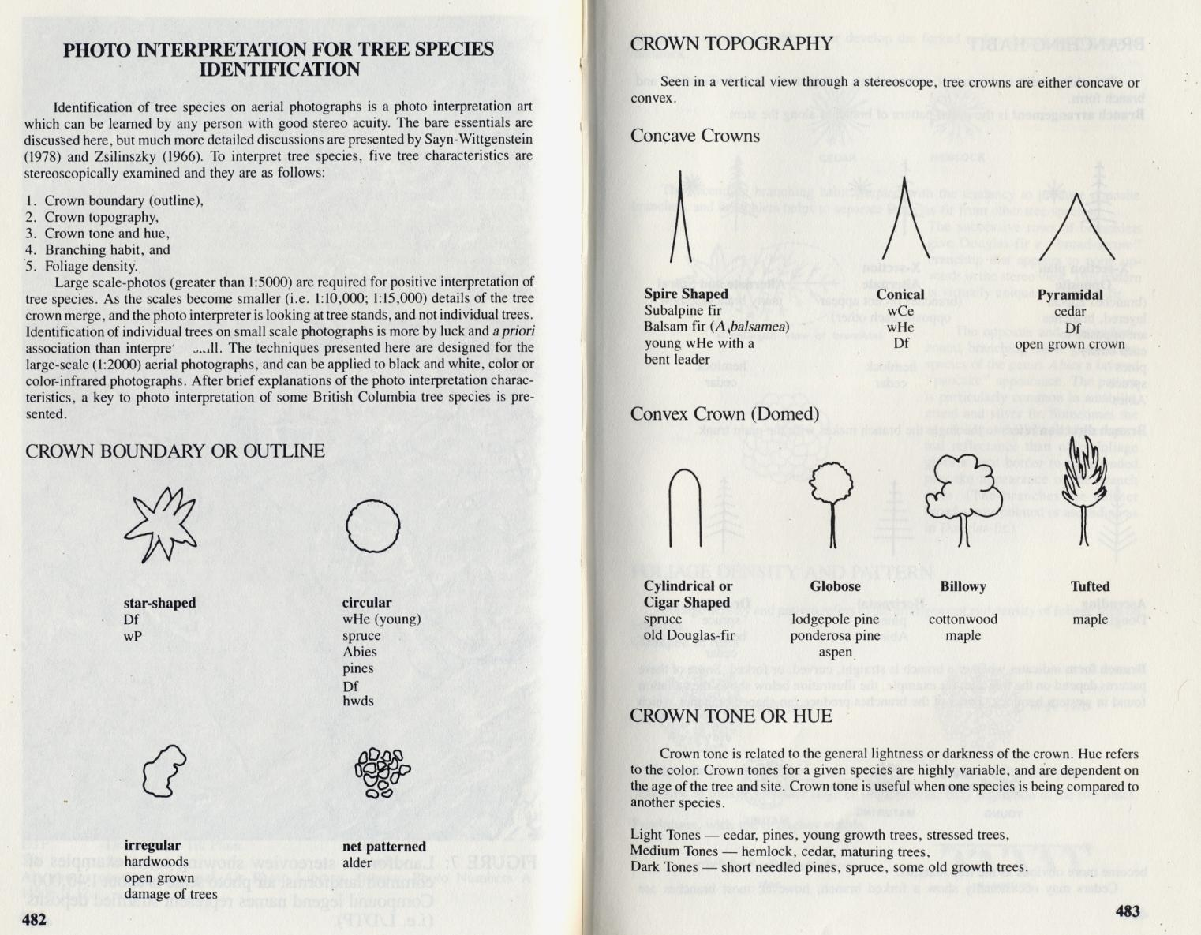
Notes:
Photo interpretation for tree species identification

Slide 3
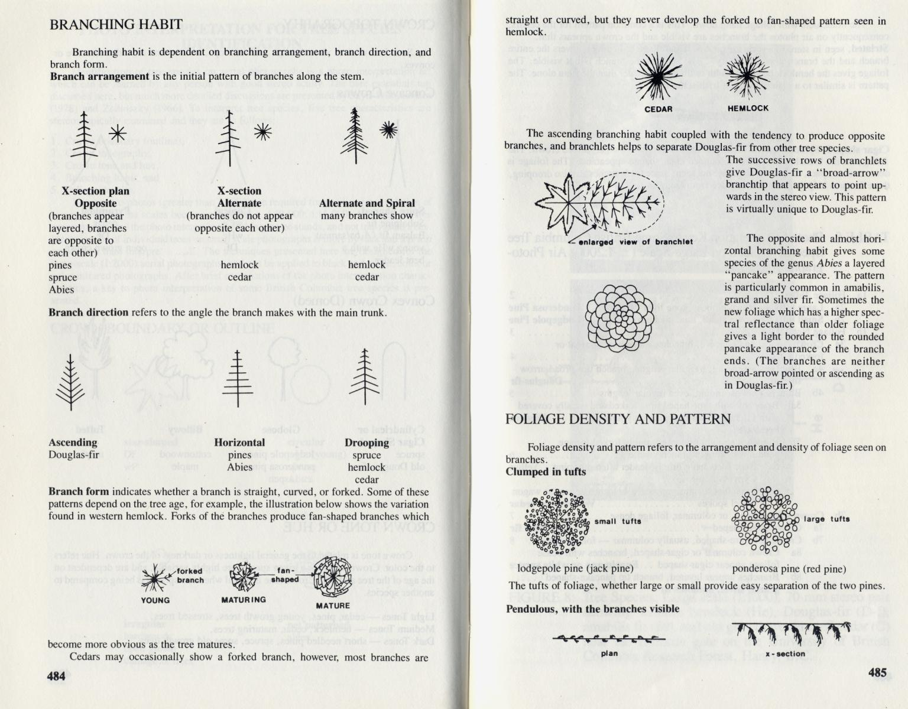

Slide 4
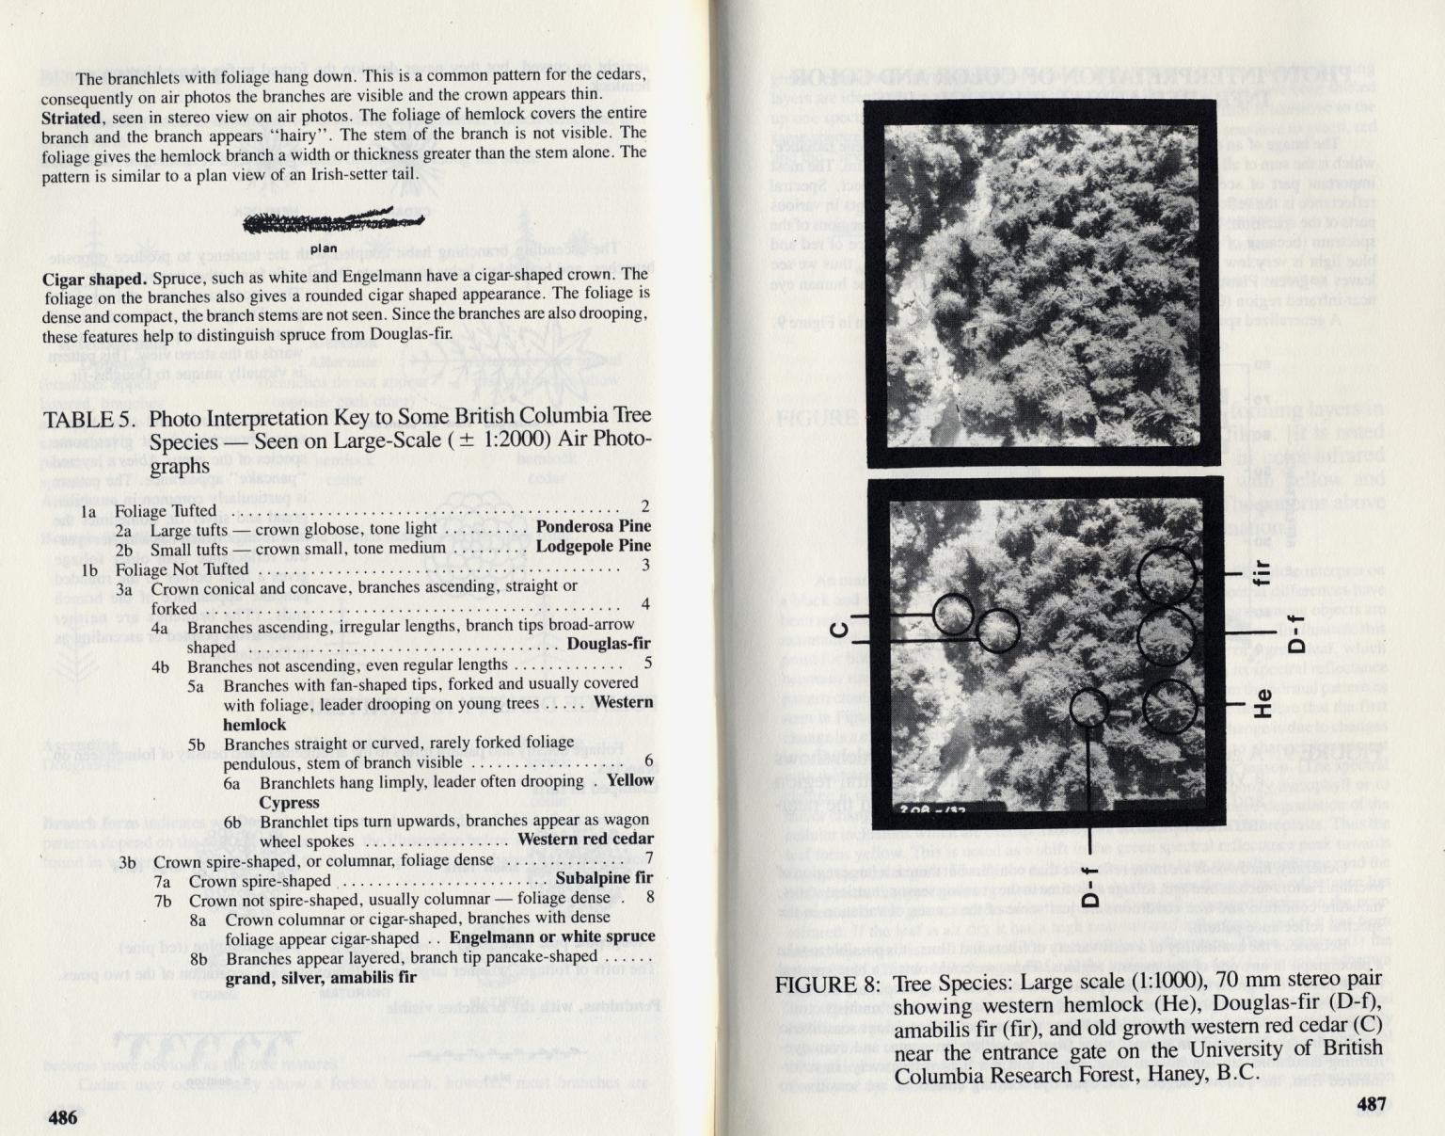

Slide 5
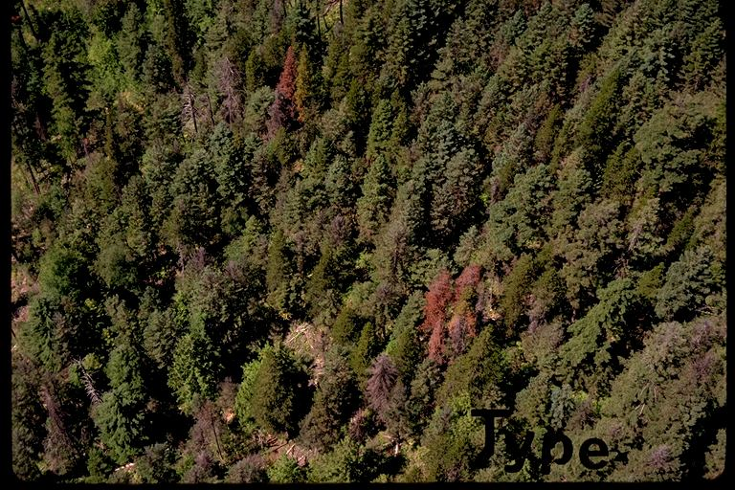
Notes:
Type of Disturbance:
• Mountain Pine Beetle (on Lodgepole Pine) of Douglas-fir Beetle (use slide for timber typing only!)
Timber Type:
• Douglas-fir & Lodgepole Pine (even mix)
Location:
• unknown
Additional Notes:
• Douglas-fir looks like spruce (however, dry terrain should be clue for Douglas-fir vs. spruce)

Slide 6
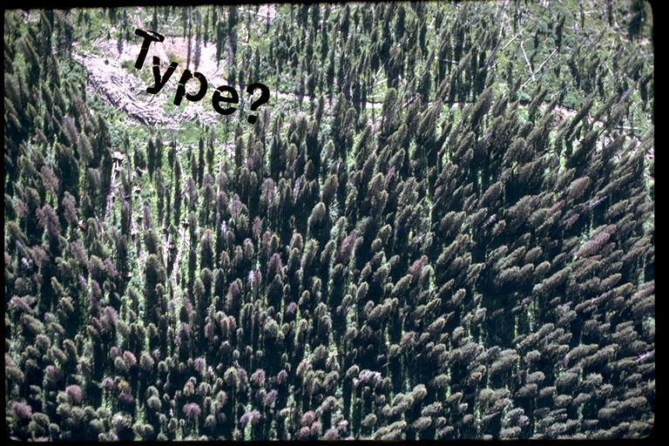
Notes:
Type of Disturbance:
• n/a (timber typing exercise)
• Spruce Beetle (some)
Timber Type:
• Spruce with some Alpine Fir (in lower right)
Location:
• unknown
Additional Notes:
• note spiked top of Alpine Fir
• Spruce cones shaped like rocket (taper quickly) but not spiked top (more conical)

Slide 7
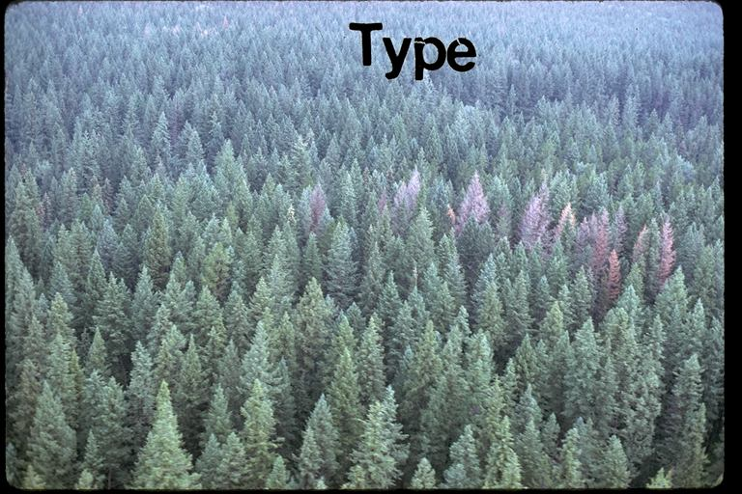
Notes:
Type of Disturbance:
• Douglas-fir Beetle
Timber Type:
• Douglas-fir (almost pure stand)
Location:
• unknown

Slide 8
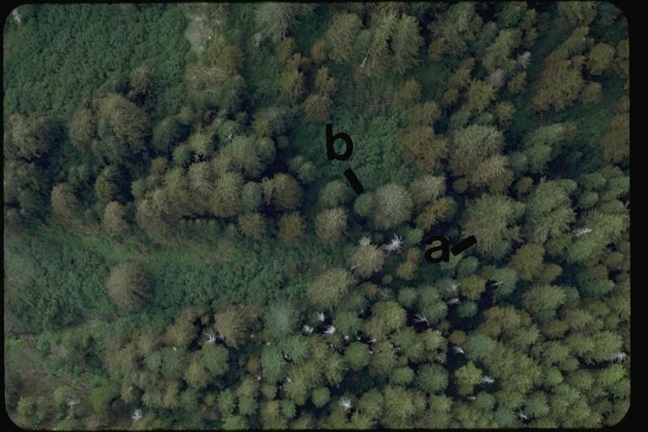
Notes:
Timber Type:
• Western Hemlock (mainly- a) with some Amabilis Fir (b)
Location:
• unknown
Additional Notes:
• note feathery texture to stand and scalloped branches of tree

Slide 9
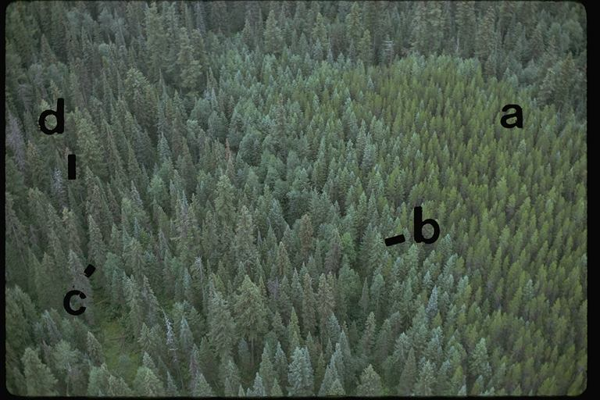
Notes:
Timber Type:
a. Lodgepole Pine
b. Douglas-fir
c. Spruce
d. Alpine Fir (spiked tops)
Location:
• unknown

Slide 10
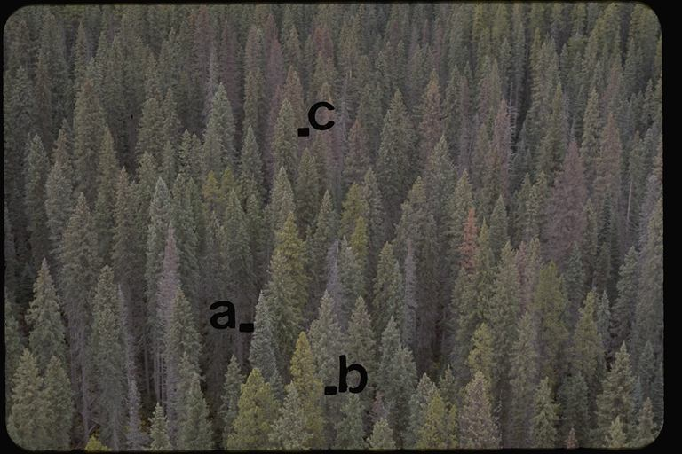
Notes:
Type of Disturbance:
• Spruce Beetle with some Mountain Pine Beetle
Timber Type:
a. Alpine Fir
b. Lodgepole Pine
c. Spruce
Location:
• unknown

Slide 11
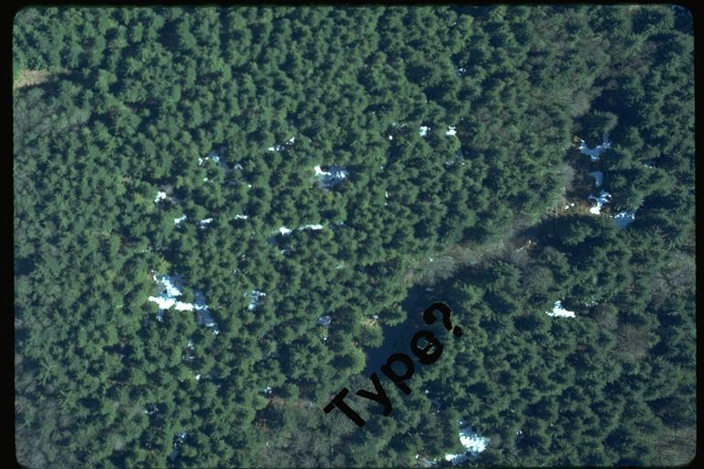
Notes:
Timber Type:
a. Western Hemlock
b. Amabilis Fir
Location:
• unknown

Slide 12
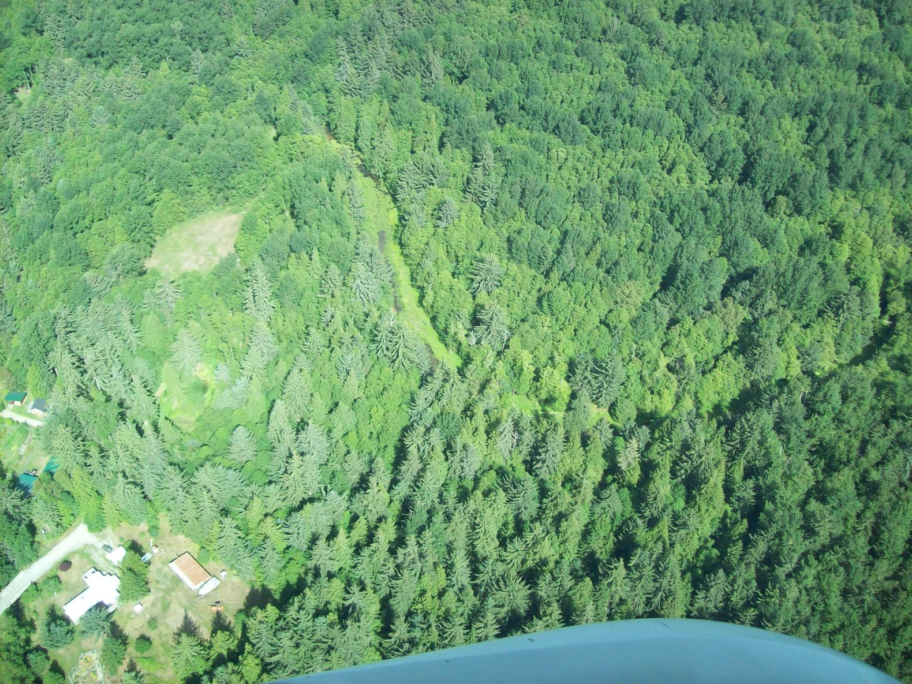
Notes:
Timber Type:
• Hemlock, amabilis fir
Location:
• near Terrace? (Sean)

Slide 13
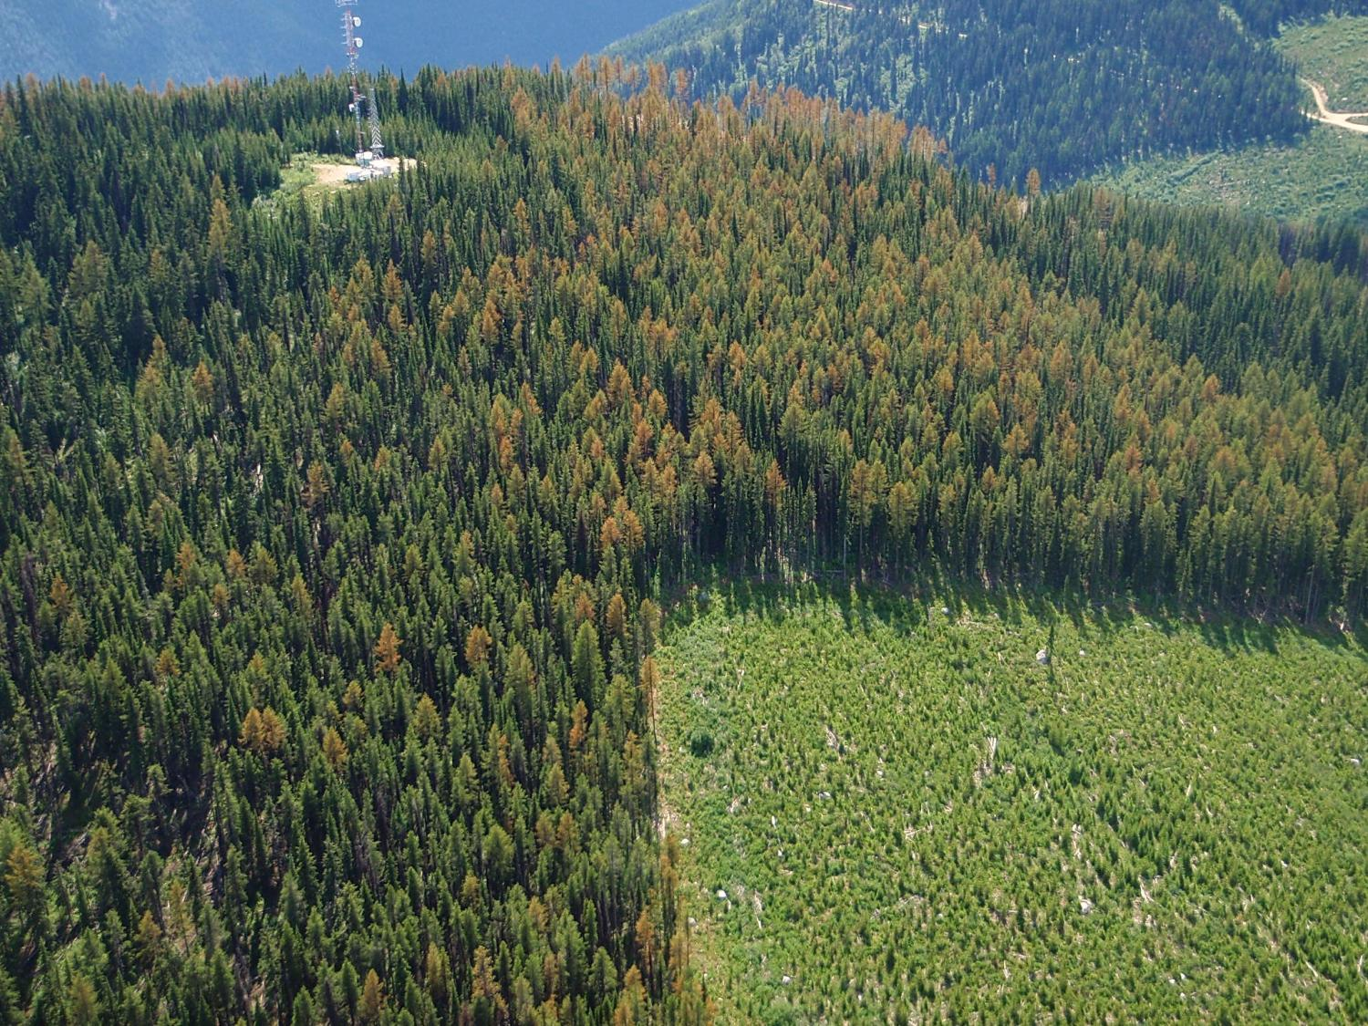
Notes:
Type of Disturbance:
• Larch needle blight
Timber Type:
• larch
Location:
• Kootenay Lake Forest District

Slide 14
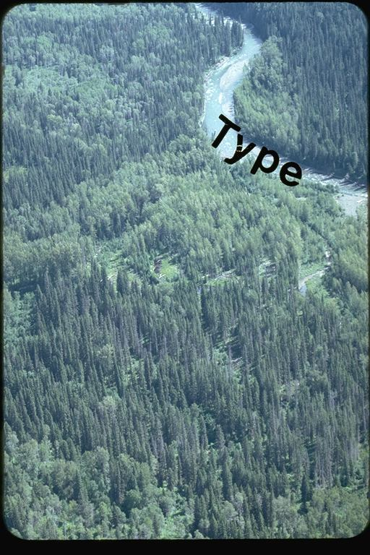
Notes:
Timber Type:
• Spruce, Trembling Aspen and Alpine Fir (spiked top)
Location:
• unknown

Slide 15
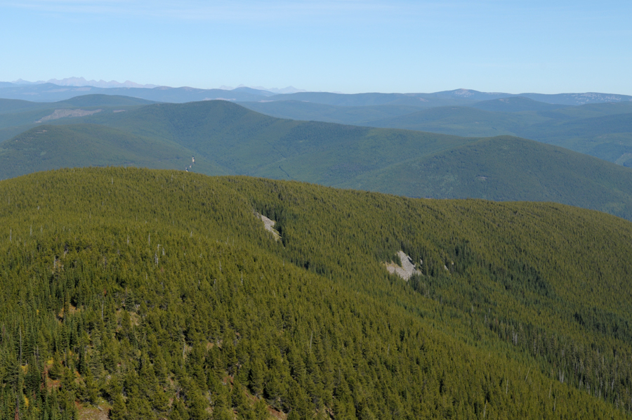
Notes:
Timber Type:
• Lodgepole Pine (almost pure)
Location:
• Hawkins Ck Kootenay Lake Forest District
Additional Notes:
• Note distinctive colour of the pine

Slide 16
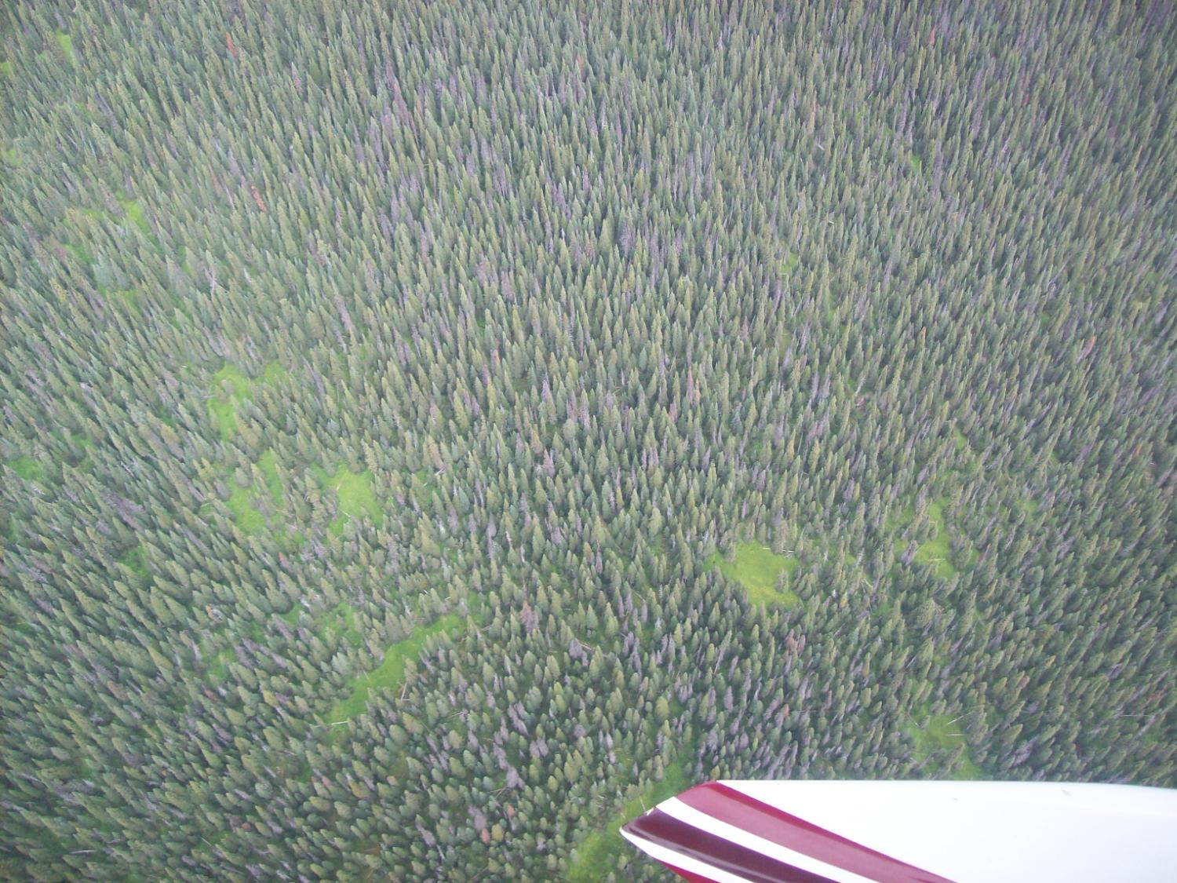
Notes:
Timber Type:
• Spruce, balsam (primarily)
Location:
• near Smithers

Slide 17
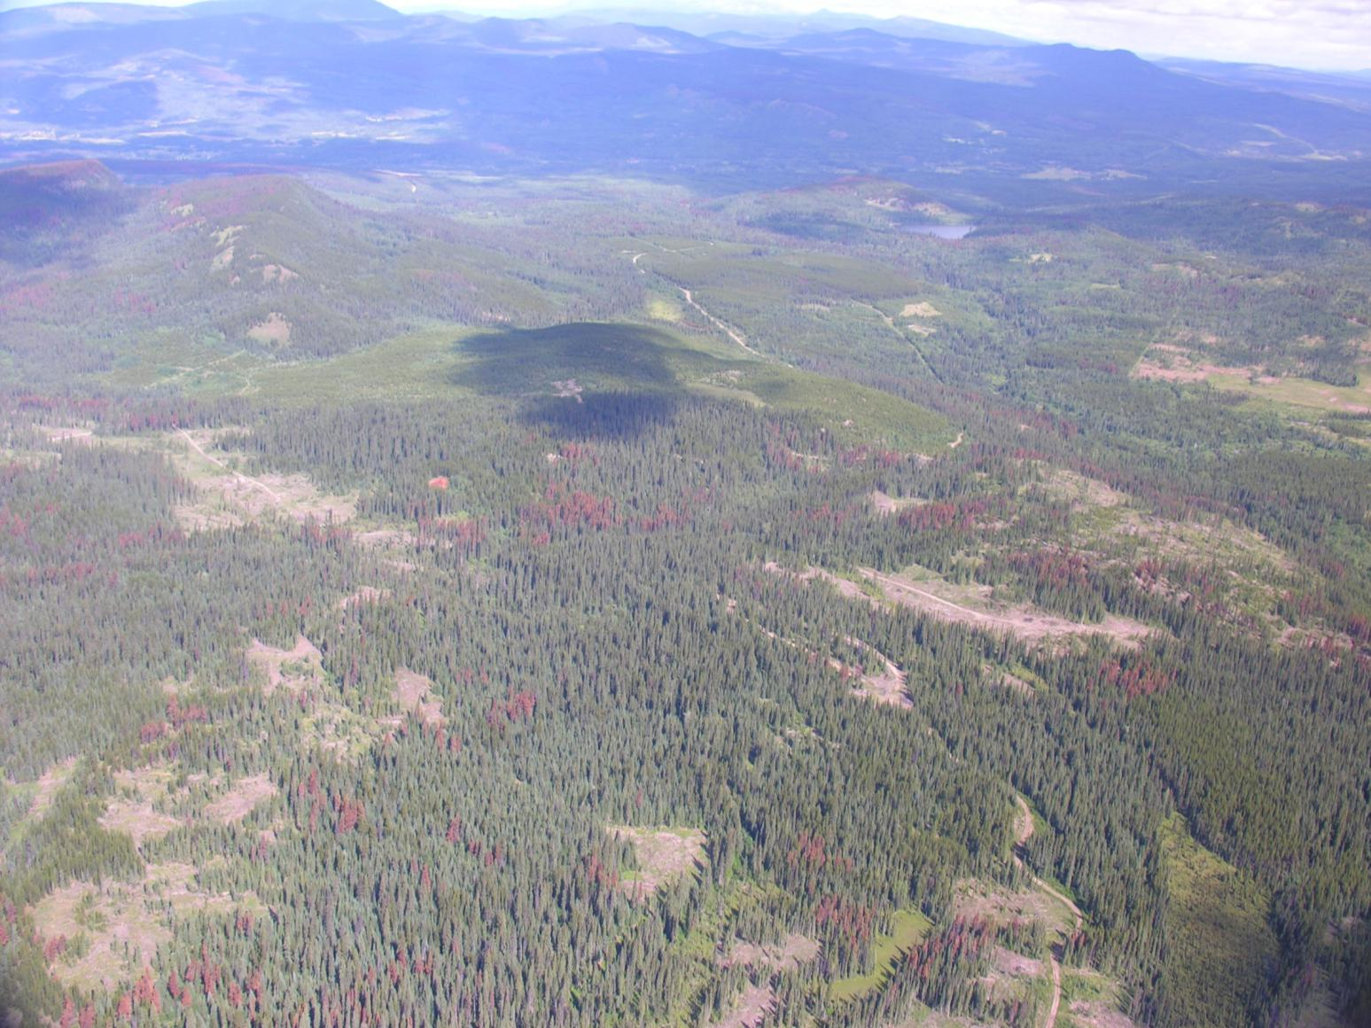
Notes:
Type of Disturbance:
• Mountain pine beetle
Timber Type:
• Lodgepole pine mixed with spruce, some balsam, lodgepole pine regen
Location:
• unknown

Slide 18
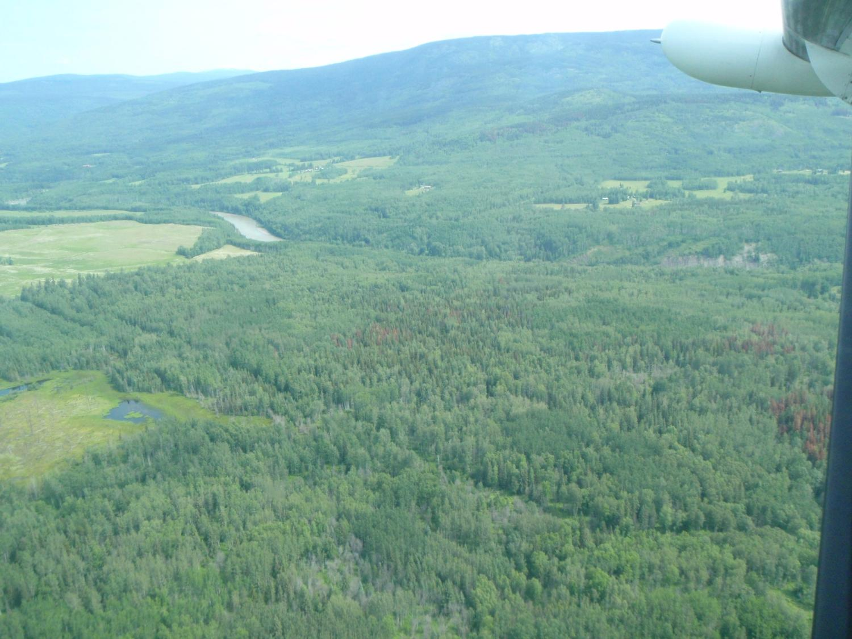
Notes:
Type of Disturbance:
• Mountain pine beetle
Timber Type:
• primarily aspen, with small clumps of lodgepole pine, a few spruce in draw, and sx/bl dark type in far background
Location:
• Smithers

Slide 19
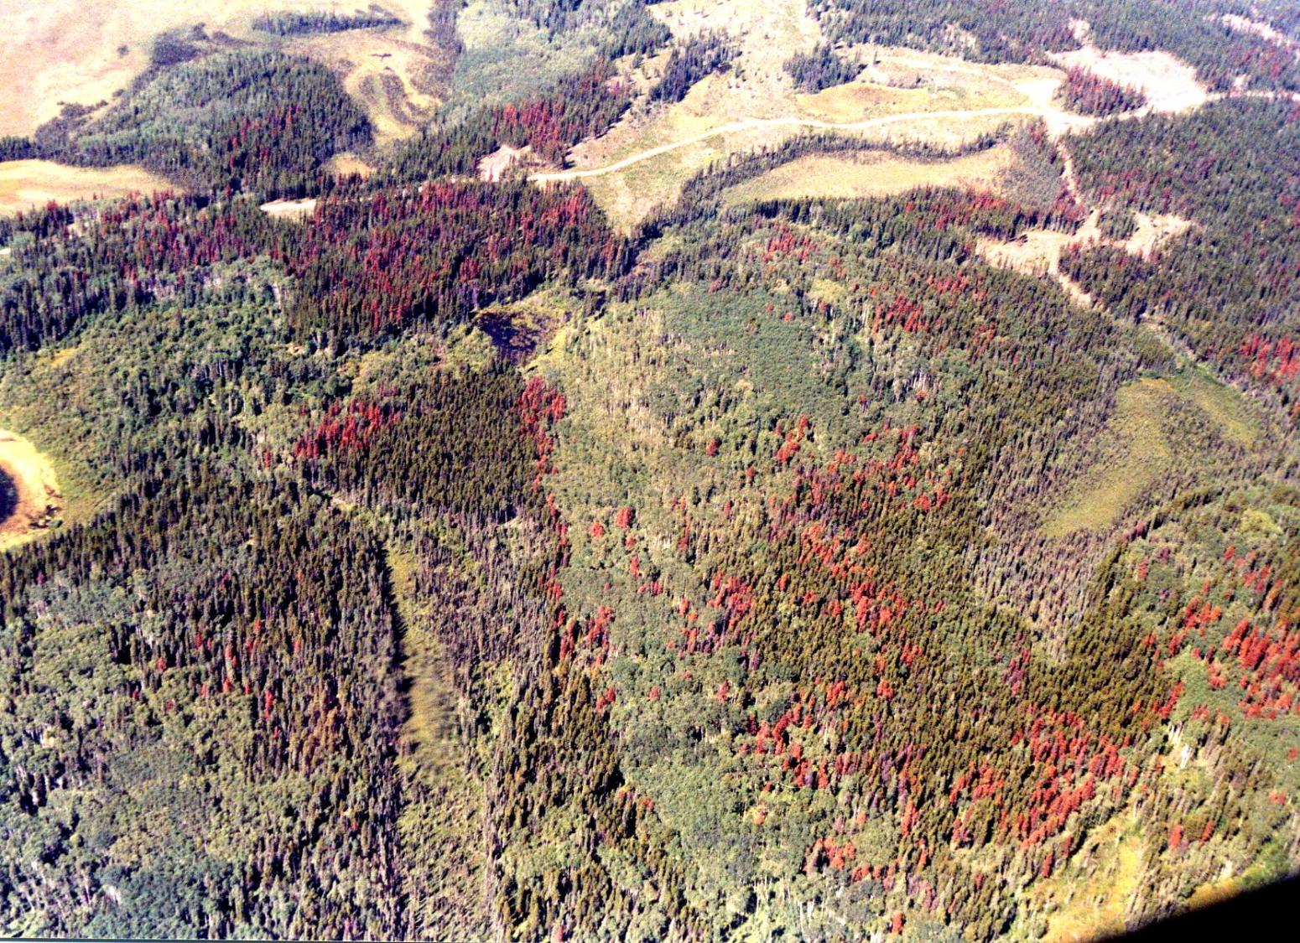
Notes:
Type of Disturbance:
• Mountain pine beetle
Timber Type:
• clumps of lodgepole pine, clumps of aspen, spruce and black spruce in low lying ares
Location:
• NIFR

